Slide 1
Disaster preparedness and Response Education System for Schools and Colleges. (Disaster Awareness and Response Portal)
CSE7302- Capstone Project
Review-2
Batch Number: CSE_119
Under the Supervision of,
Dr.Pamela Vinitha Eric
Professor
School of Computer Science and Engineering
Presidency University
Roll Number | Student Name
20221CSE0090 | P Vishnu Vardhan
20221CSE0195 | S Vasista
20221CSE0225 | A Dhanush
Name of the Program: CSE
Name of the HoD: Dr.Blessed Prince
Name of the Program Project Coordinator: Dr. Muthuraj
Name of the School Project Coordinators: Dr. Sampath A K , Dr. Geetha A

Slide 2
Problem Statement Number: SHI25008
Category: Software
Organization: Educational Institutions (Schools & colleges)
Problem Description: Natural disasters such as earthquakes, floods, fires, and cyclones cause severe damage to life and property every year. Schools and colleges often lack structured disaster preparedness education, practical training modules, and real-time guidance systems. Existing awareness programs are mostly theoretical, outdated, or conducted irregularly, leading to poor preparedness among students and staff. There is a need for a centralized, interactive, and accessible web-based system that educates students about disaster preparedness, safety protocols, and emergency response procedures in a simple and engaging manner.

Slide 3
Problem Statement Number: SHI25008
Abstract :
This project proposes a web-based Disaster Preparedness and Response Education System to educate students on effective actions before, during, and after disasters.
The system provides interactive learning modules, preparedness checklists, and scenario-based quizzes to improve understanding and retention.
A role-based platform is designed where administrators can manage content and students can track their learning progress.
The application focuses on simple language, visual learning, and student-centric design to ensure ease of understanding.
The proposed system aims to improve disaster awareness, preparedness, and response capabilities among young learners, thereby reducing panic and improving safety during emergencies.

Slide 4
Problem Statement Number: SHI25008
Objectives:
To develop a digital platform for disaster preparedness and response education for school and college students.
To educate students on safety measures before, during, and after disasters.
To provide interactive learning modules and quizzes for better understanding and retention.
To improve student awareness through preparedness checklists and scenario-based learning.
To enable easy access to disaster safety information through a user-friendly interface.
To enhance overall disaster readiness and response capability among students.
GitHub Link:
“ https://github.com/vishnu090705/Disaster-awareness-Response-portal- “

Slide 5
Problem Statement Number: SHI25008
Existing Methods :
Disaster information is mainly provided through government websites, PDFs, manuals, and notices.
Awareness is created through occasional workshops, drills, or seminars in schools and colleges.
Information is mostly text-based and theoretical in nature.
Training programs are usually one-time and not continuous.
Drawbacks of Existing Methods:
Limited accessibility and low student participation.
Lack of practice-oriented learning such as quizzes or simulations.
No system to track learning progress or preparedness level of students.
Information is often complex and hard to understand for students.

Slide 6
Problem Statement Number: SHI25008
Provide structured learning modules for different disasters, organized as Before–During–After.
Proposed Method:
Develop a web-based interactive disaster education system for schools and colleges.
Provide structured learning modules for different disasters, organized as Before–During–After.
Include preparedness checklists and scenario-based quizzes to reinforce learning.
Implement role-based access for students and administrators to manage and consume content.
Store and manage data securely using a backend server and database.

Slide 7
Problem Statement Number: SHI25008
Provide structured learning modules for different disasters, organized as Before–During–After.
Feasibility Study:
Technical Feasibility:
Uses widely available technologies such as Node.js, and MongoDB.
Can run on standard systems and web browsers without special hardware.
Economic Feasibility:
Uses open-source tools, reducing development and deployment cost.
Low maintenance and scalable for future expansion.
Operational Feasibility:
Easy to use by students and teachers with minimal training.
Can be integrated into existing school and college learning environments.

Slide 8
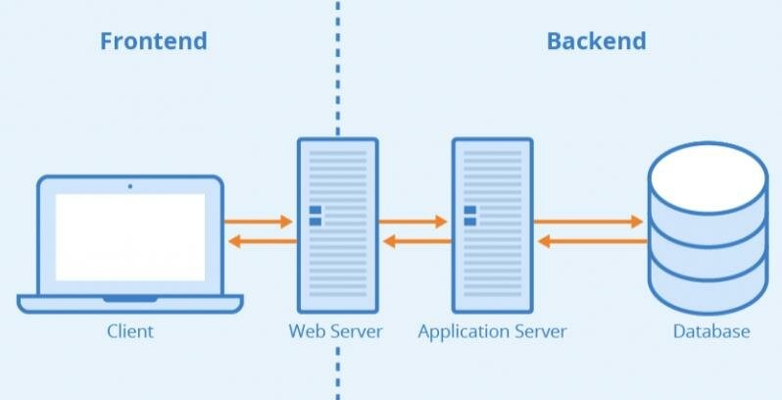
Problem Statement Number: SHI25008
Provide structured learning modules for different disasters, organized as Before–During–After.
Architecture Diagram:

Slide 9
Problem Statement Number: SHI25008
Provide structured learning modules for different disasters, organized as Before–During–After.
Modules:
User Authentication Module:
Handles user registration and login.
Provides role-based access (Student / Admin).
Disaster Learning Module:
Provides educational content for different disasters (Earthquake, Flood, Fire, Cyclone).
Content is structured into Before, During, and After phases.
Quiz & Assessment Module:
Conducts quizzes after completion of learning modules.
Enhances understanding through scenario-based questions.
Admin Management Module:
Allows admins to add, update, and delete learning content.
Manages quiz questions and preparedness steps.
Monitors overall system usage and student participation.

Slide 10
Problem Statement Number: SHI25008
Visual Studio Code
Hardware Details:
Internet Connection: Required for database and server access.
Software Details:
Frontend: HTML5, CSS3, JavaScript
Backend: Java 17, Spring Boot 3.2
Database: MongoDB
Tools & Platforms: Visual Studio,Git&Git-Hub

Slide 11
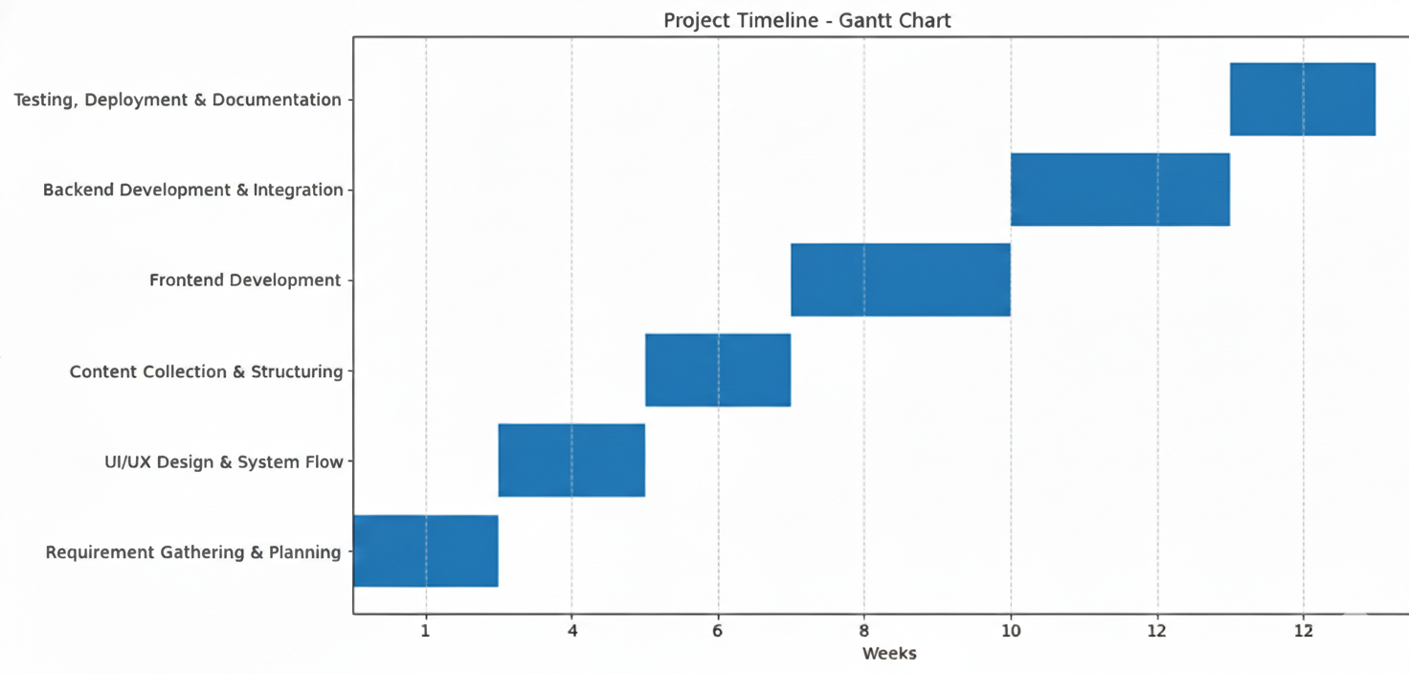
Problem Statement Number: SHI25008
Timeline of the project(Gantt Chart):

Slide 12
Problem Statement Number: SHI25008
References:
[1]National Disaster Management Authority (NDMA), National Disaster Management Guidelines, Government of India, New Delhi, India, 2019. [Online]. Available: https://ndma.gov.in
[2] United Nations Office for Disaster Risk Reduction (UNDRR), Sendai Framework for Disaster Risk Reduction 2015–2030, United Nations, Geneva, Switzerland, 2015. [Online]. Available: https://www.undrr.org
[3] Ready.gov, Emergency Preparedness and Response Guidelines, U.S. Department of Homeland Security, Washington, DC, USA, 2023. [Online]. Available: https://www.ready.gov
[4] National Disaster Response Force (NDRF), Disaster Response Training and Awareness Materials, Ministry of Home Affairs, Government of India, New Delhi, India, 2022. [Online]. Available: https://ndrf.gov.in
[5]United Nations Children’s Fund (UNICEF), Disaster Risk Reduction in Education, UNICEF Publications, New York, USA, 2021. [Online]. Available: https://www.unicef.org/disaster-risk-reduction

Slide 13


